Slide 1
Symmetry Guided Gradient Descent
The scaling report

Slide 2
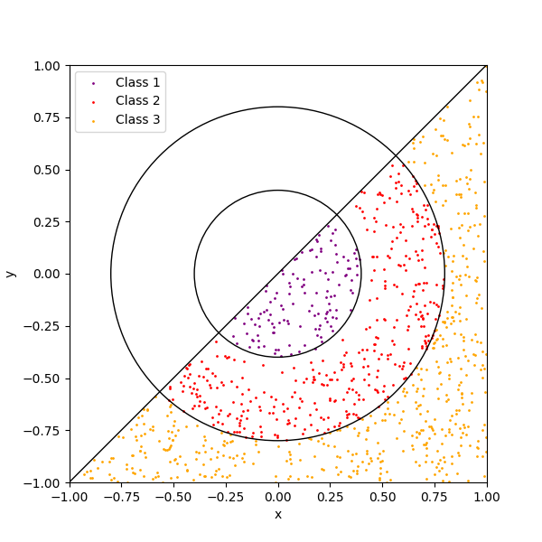
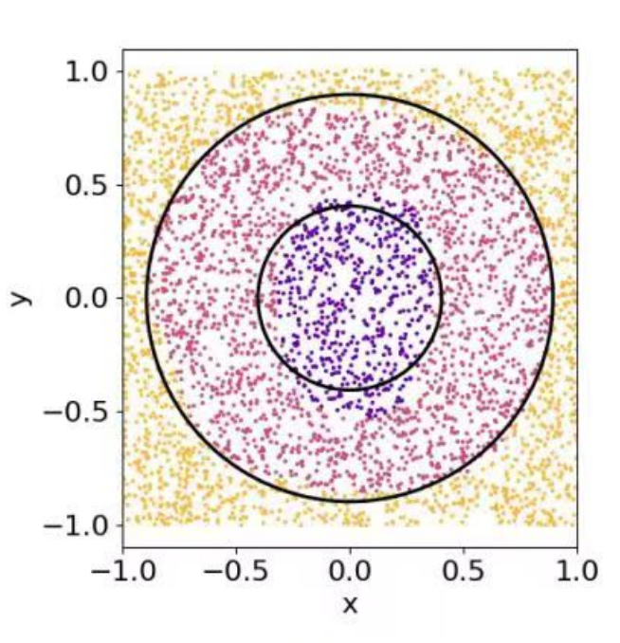
The Task
Target
Training samples

Slide 3
QNN set up
x
y
Encoded
2 layers

Slide 4
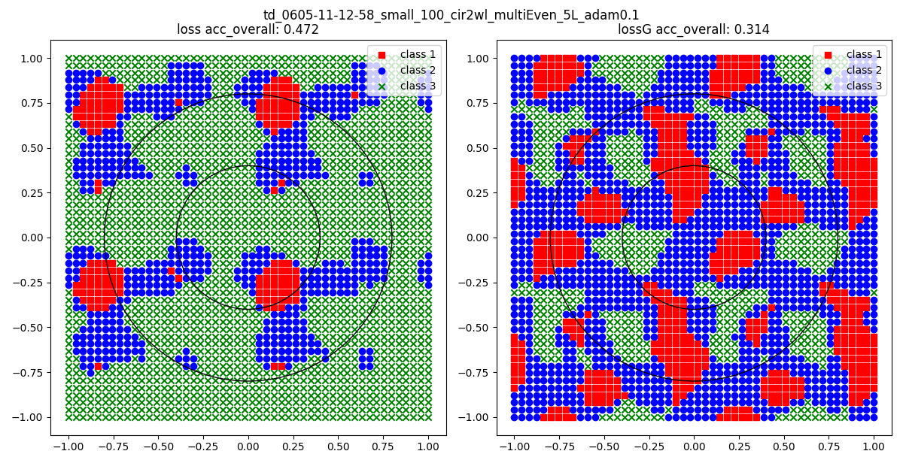
Result of 128 samples
Layer number: 5
Run time : 35 min
I thought that the result is bad because the training samples are too small. So I enlarge the sample number.
* sample number means the number of training data

Slide 5
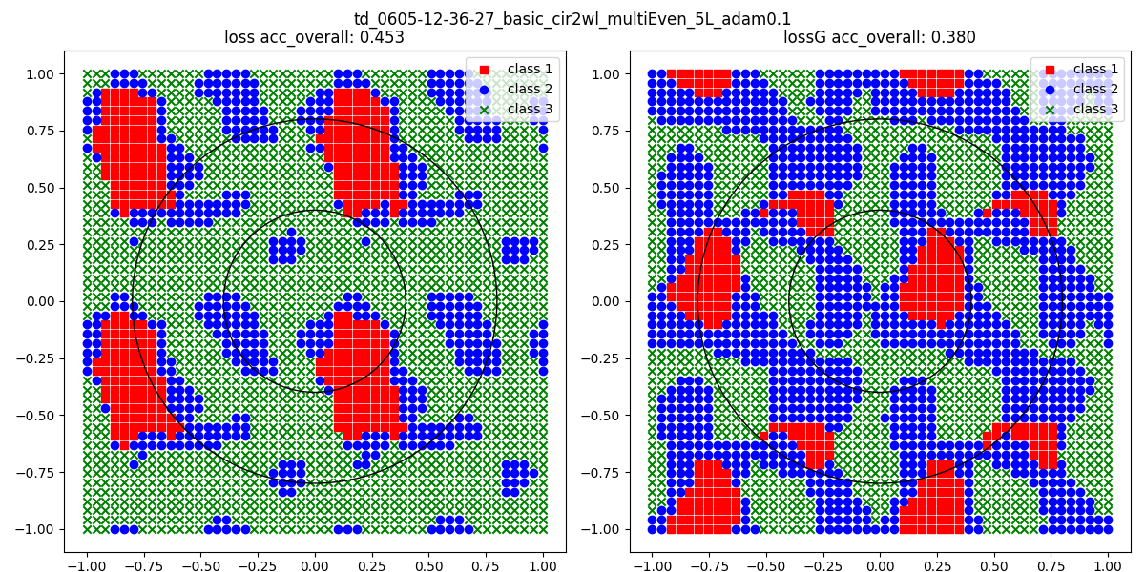
Result of 1000 samples
Layer number: 5
Run time : 9.5h
As you can see, the result doesn’t become well when we enlarge the sample number.
I thought its because the layer number is too small.

Slide 6
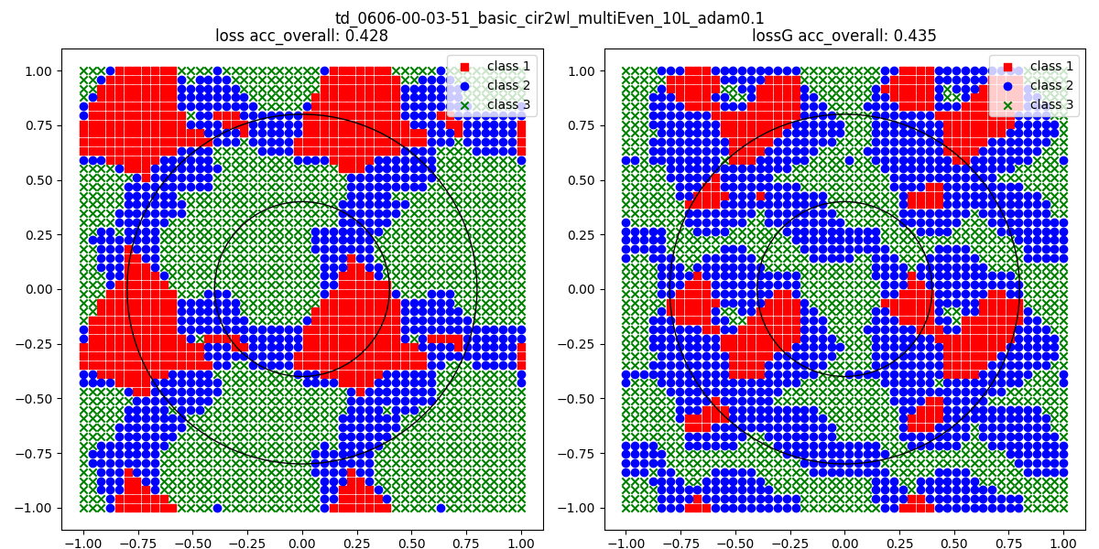
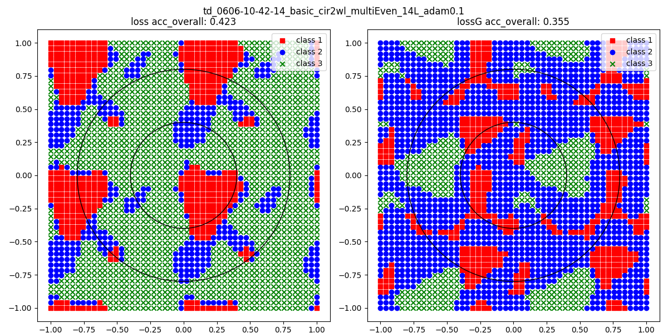
Result of 512 samples
Layer number: 10
Run time : 9h
As you can see, the result doesn’t become well when we enlarge the layer number.
Layer number: 14
Run time : 11.5h

Slide 7
Conclusion:
I think the results are bad because the vanilla gradient descent is bad.
Symmetry guidance could not help the model to gain more “generalization ability” . Instead, it avoid the model to stuck in “wrong place”.

